Slide 1
The Computer Fraud and Abuse Act (CFAA)
Sven Wiberg

Slide 2
What does it do?
The CFAA was designed in attempt to protect computers from “unauthorized access“
It also made illegal trading in malicious code and protected data

Slide 3
Which one of these scenarios is Illegal?
Breaking into a protected database and downloading whatever data you want
Accessing a database through an open network and downloading files from that database
Modifying a game console through accessing the software
Using your work computer to look for another job

Slide 4
SURPRISE!!!!
They are all illegal under the CFAA

Slide 5
The problem
The CFAA says that “unauthorized access” of a computer is illegal
It does not define exactly what “Unauthorized access” entails
This leaves a lot of room for prosecutorial digression
The law only applies to computers used by financial institutions and the federal government as well as computers used for interstate in foreign commerce
In practice this applies to any ordinary computer due to the nature of the internet

Slide 6
The history of the CFAA
The law was enacted in 1986
Was meant to update the existing computer fraud law
The law has been amended multiple times, often expanding the scope of the law
The creators of the law were influenced in creating the law by the movie WarGames(1983)

Slide 7
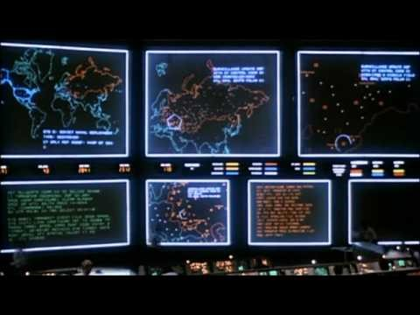

Slide 8
Fixing the CFAA
There are several different ways the CFAA can be fixed
Support proportionality in sentencing for computer crimes
Write your congressional representative to support Aaron’s law a bill that aims to correct major flaws in the current hacking law
Write your congressional official supporting an updating of the current law to better define unauthorized access
Support education about computers

Slide 9
Questions
How should legislation attempt to protect computers?
How should unauthorized access be defined?
What kind of penalties should there be for unauthorized access? Should it be

